Slide 1
Home Learning Task

Slide 2
For this exercise , I used Postgresql not MySQL and a French DataSet

Slide 3
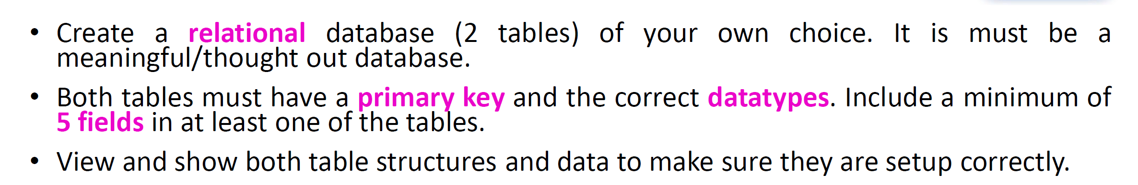
I used for this exercice a French DataSet from the gov related to the housing and sales of houses,flat,etc… To have the database use/open the file : Proof_of_concept.sql

Slide 4
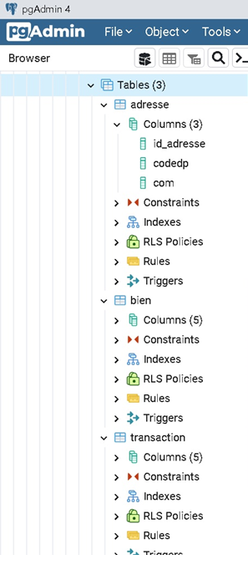

Slide 5
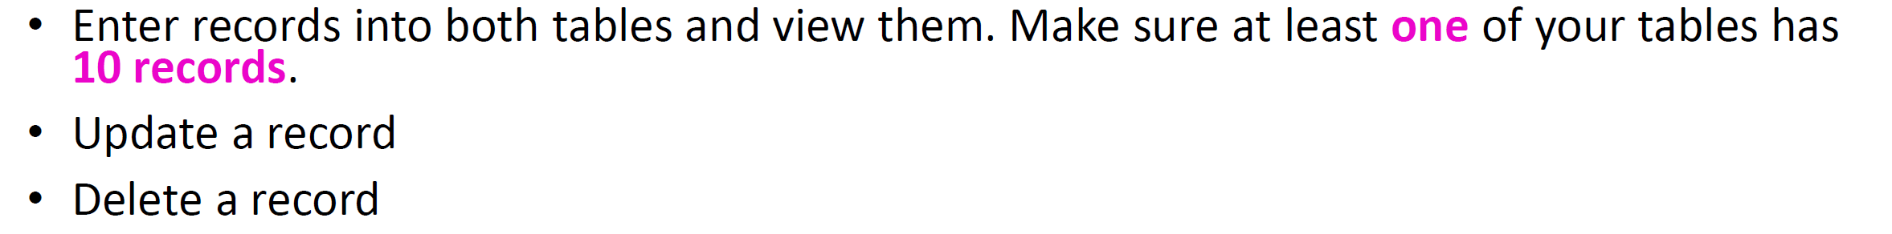
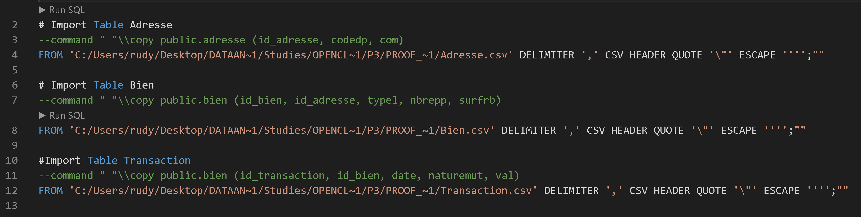
I used 3 csv files ( adresse,bien,transaction ) and Imported the values

Slide 6
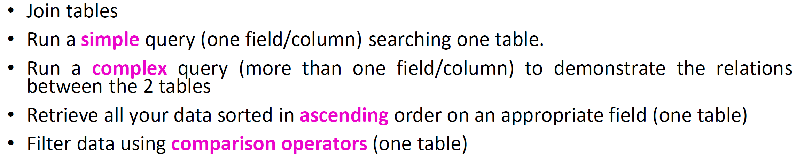
I Runned some complexed queries :

Slide 7
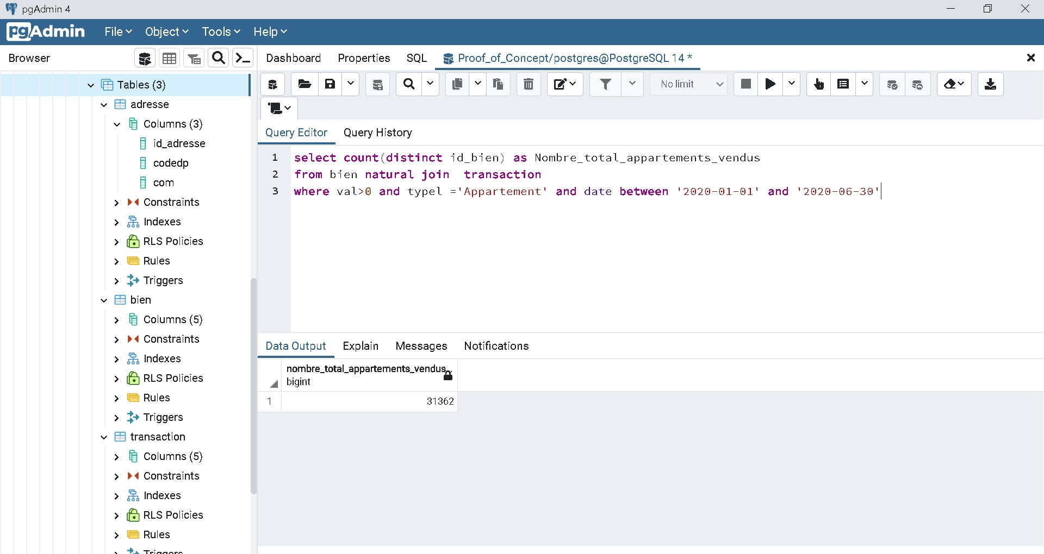
1. Number of flat ( appartements in french) sold in the 1st semestre 2020.

Slide 8
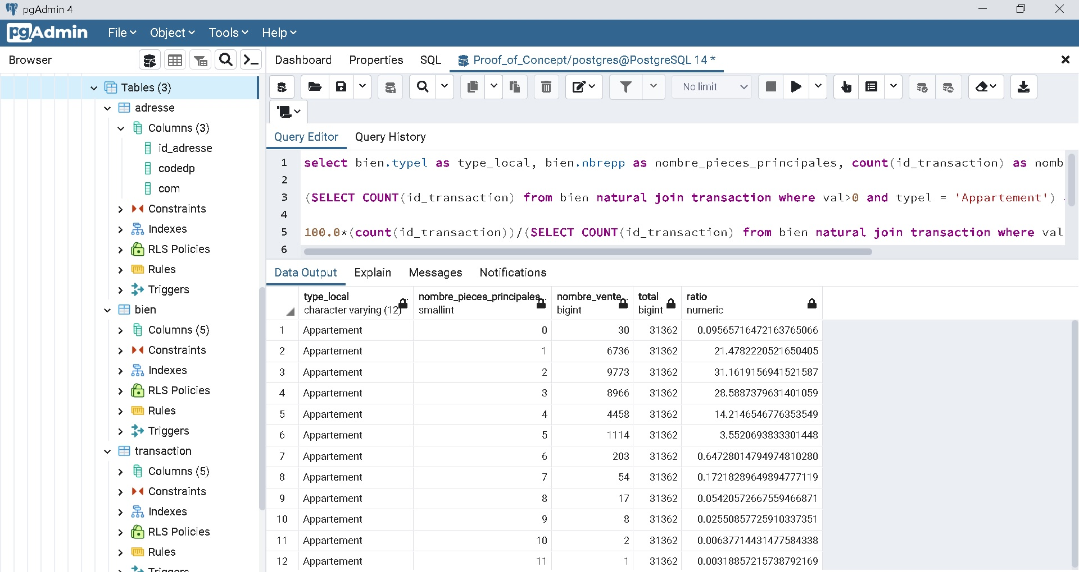
2. Proportion of flat sales regarding/depending of the number of rooms

Slide 9
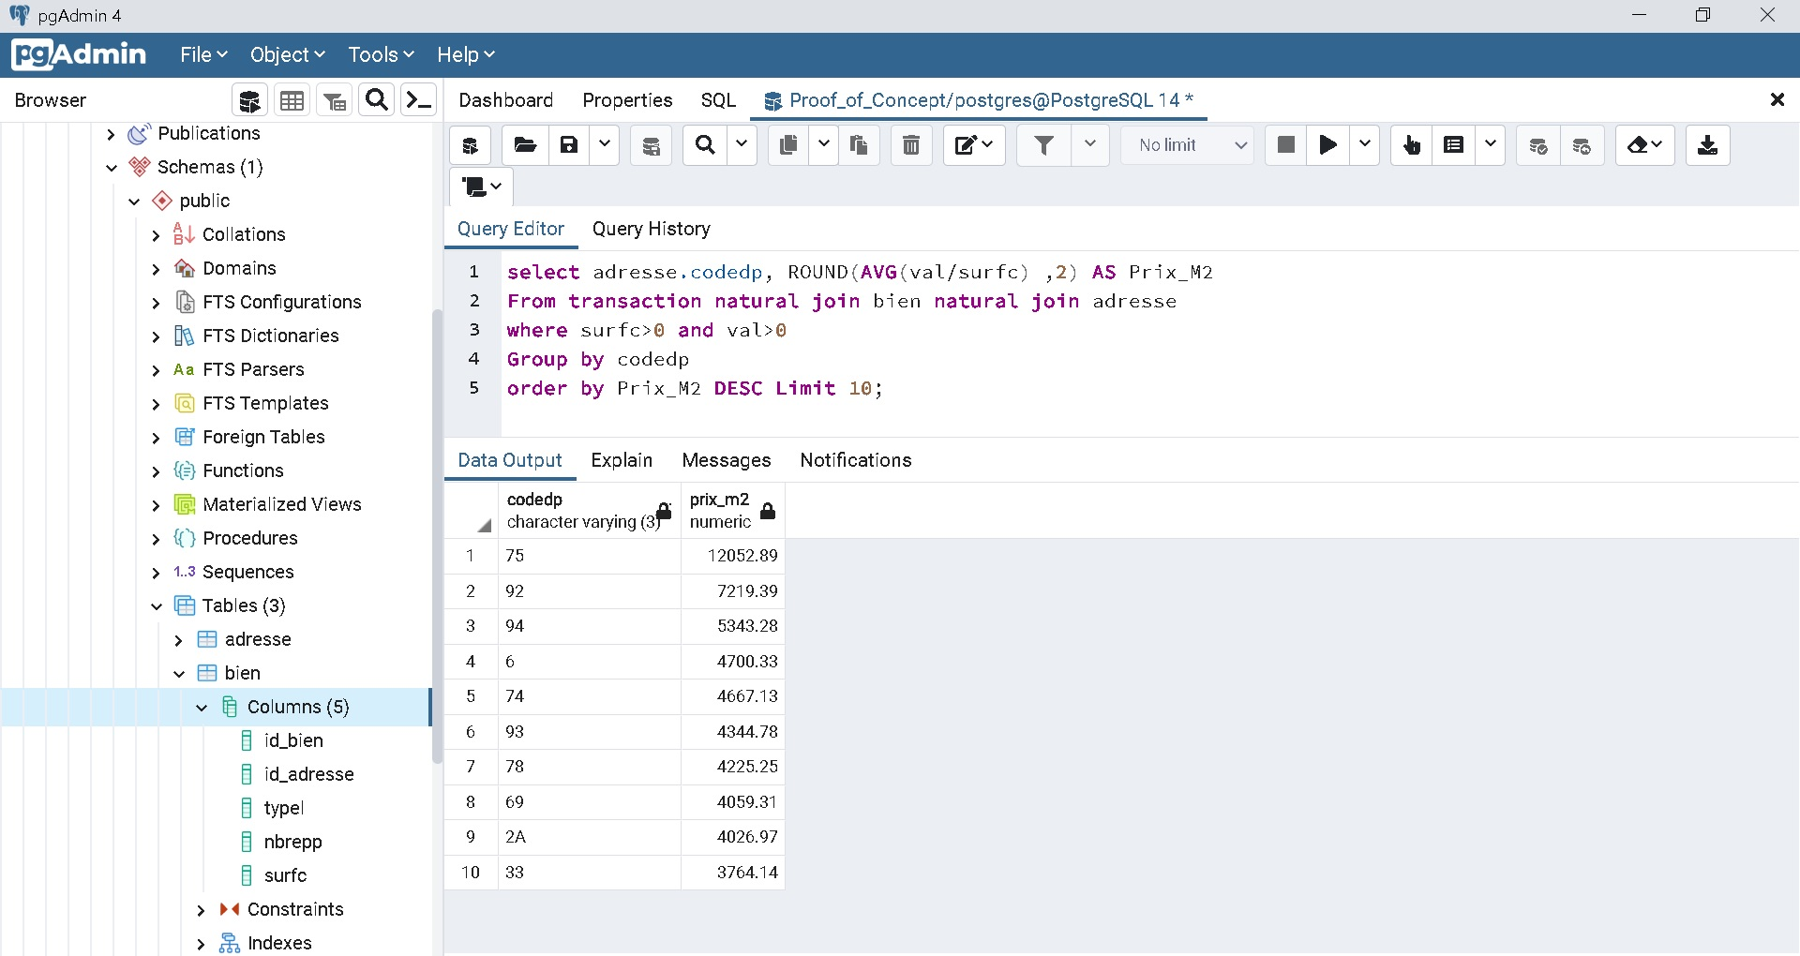
3. Lisf of the 10 territory where the square meter price is the highest.

Slide 10
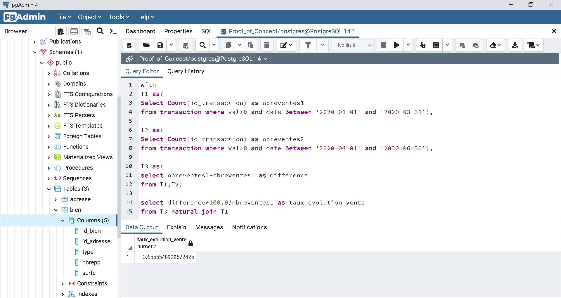
6. Evolution rate of the sales number between the 1st and the 2nd trimester of 2020.

